Slide 1
How NextUp Transition Curriculum Can Enhance Your School’s Transition Program and Services
Presented by: Corey Fineran, CEO and Tawny Fineran, Sales Director

Slide 2
NextUp’s Misson
To serve educators and students by providing adaptable, comprehensive, and relevant transition curriculum to promote competitive employment, post-secondary training, and independent living success.
NextUp was created by experienced transition educators and professionals with a passion for student success.

Slide 3
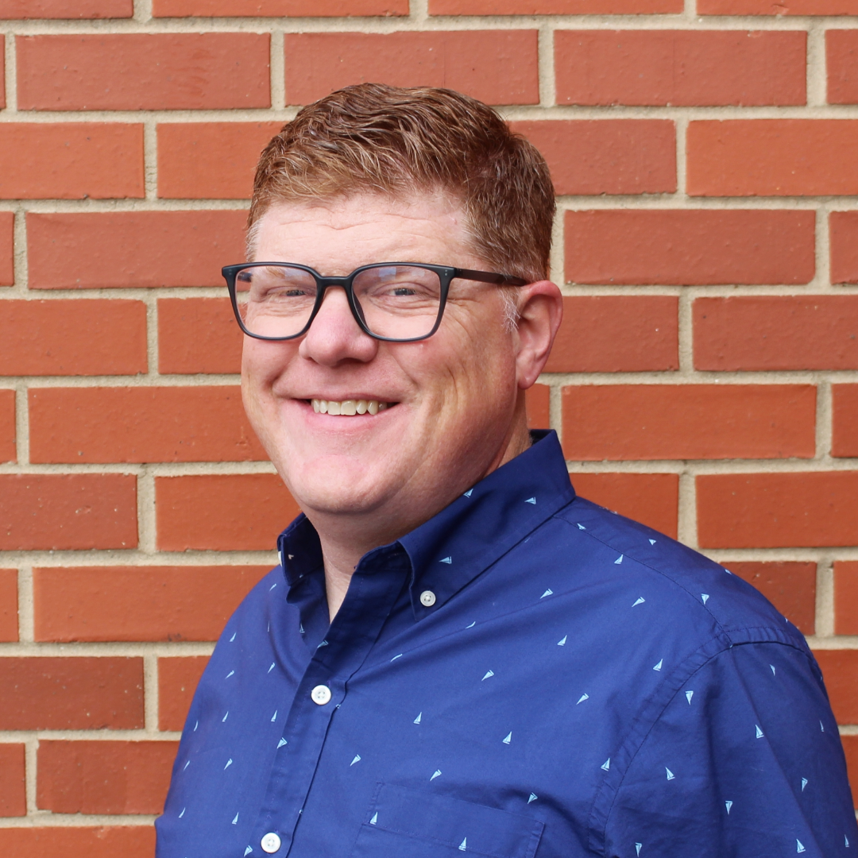
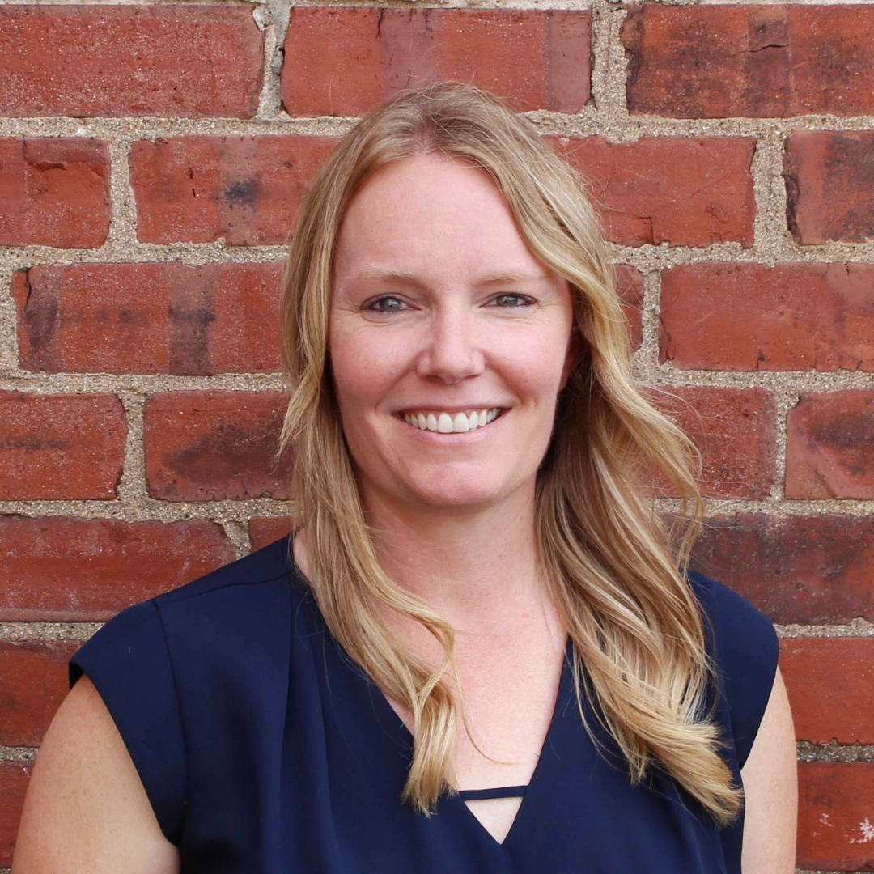
Meet the NextUp Co-Founders
Corey Fineran Lindsay Zerull

Slide 4
NextUp Product Features
Engaging Online Video Lessons
Adaptable Lesson Plans
Leveled Extension Activities
Assessments
Pre- and post-lesson, informal transition, and growth assessments
LMS Compatibility
Unlimited Users per Campus
Standards Aligned
Student Business Platform
Online Job Application Simulator

Slide 5
NextUp Portal Tour
www.NextUp.work

Slide 6
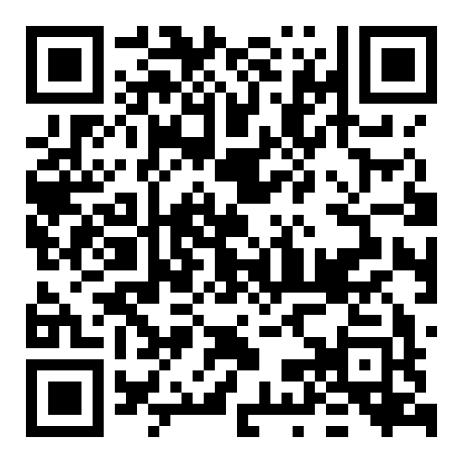
Transition Planning Resources
http://transitioncurriculum.com/transitionplanning

Slide 7
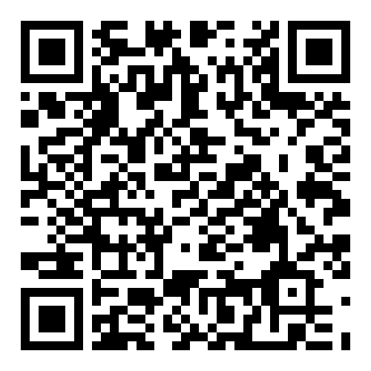
Student Business Resources
http://transitioncurriculum.com/studentbusinessresources

Slide 8
Request a Free NextUp Lesson!

Slide 9
Thank you!
Contact:
Corey.Fineran@transitioncurriculum.com
Tawny.Fineran@transitioncurriculum.com
Resources:
http://transitioncurriculum.com/conference

