Slide 1
How NextUp Transition Curriculum Can Enhance Your School’s Transition Program and Services
Presented by: Corey Fineran, Co-founder/ CEO and Lindsay Zerull, Co-founder/Content Director

Slide 2
NextUp’s Mission
To serve educators and students by providing adaptable, comprehensive, and relevant transition curriculum to promote competitive employment, post-secondary training, and independent living success.
NextUp was created by experienced transition educators and professionals with a passion for student success.

Slide 3
NextUp Product Features
Engaging Online Video Lessons
Adaptable Lesson Plans
Leveled Extension Activities
Assessments
  Pre- and post-lesson, informal transition, and growth assessments
LMS Compatibility
Unlimited Users per Campus
Standards Aligned
Student Business Platform
Online Job Application Simulator

Slide 4
NextUp Portal Tour
https://nextup.work

Slide 5
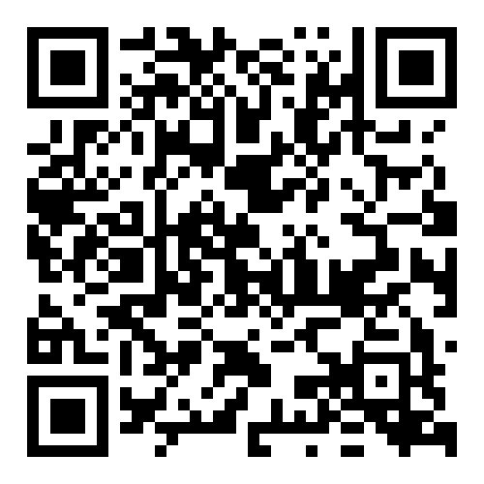
Transition Planning Resources
http://transitioncurriculum.com/conference

Slide 6
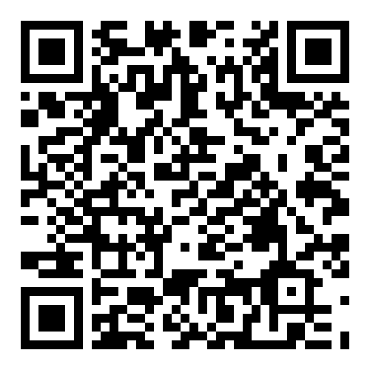
Student Business Resources
http://transitioncurriculum.com/conference

Slide 7
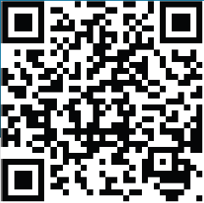
Request a Free NextUp Lesson!

Slide 8
Thank You!
Contact:
  Corey.Fineran@transitioncurriculum.com
  Lindsay.Zerull@transitioncurriculum.com
Resources:
  http://transitioncurriculum.com/conference

